Slide 1

Your past, your present and your future

Slide 2


Slide 3
IDEA
What is Capsulefy?

Slide 4





Time capsule

Slide 5


Payment plans
 | Free | Premium
Price | 0 € | 11.99 €
Storage | 20 MB/user | 500 MB/capsule
Social network and email integration
Capsule scheduling | 1 year | No limit
Capsule expiration | 6 months after release | No expiration
Modular and private capsules

Slide 6
COMPETITORS
What makes us different?

Slide 7
 | Viajeros en el tiempo | Mytimecapsule | Miigen | thetimecapsule | Capsulefy
Automatic content publication
Free plan
Premium plan
Images
Videos
Social network integration
Deadman switch

Slide 8
 | Milegadodigital | Capsulefy
Not restricted to last wills
No family certificate required
Free plan
 | Mytimecapsule | Milegadodigital | Capsulefy
Price | 8.97 € | 79 € | 11.99 €
Features | 100 MB storage | Online last will basic plan | 500 MB storage

Slide 9
TEAM
Who is behind?

Slide 10
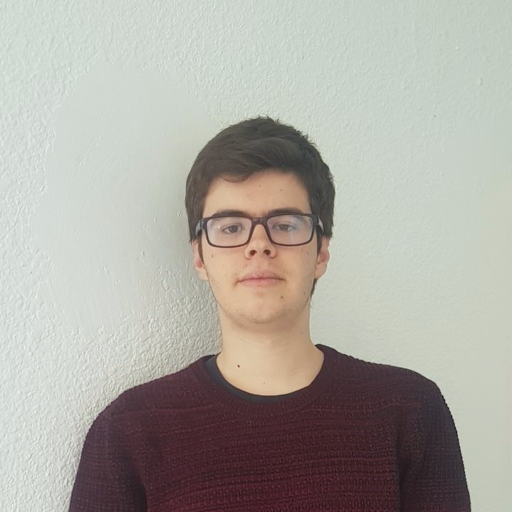






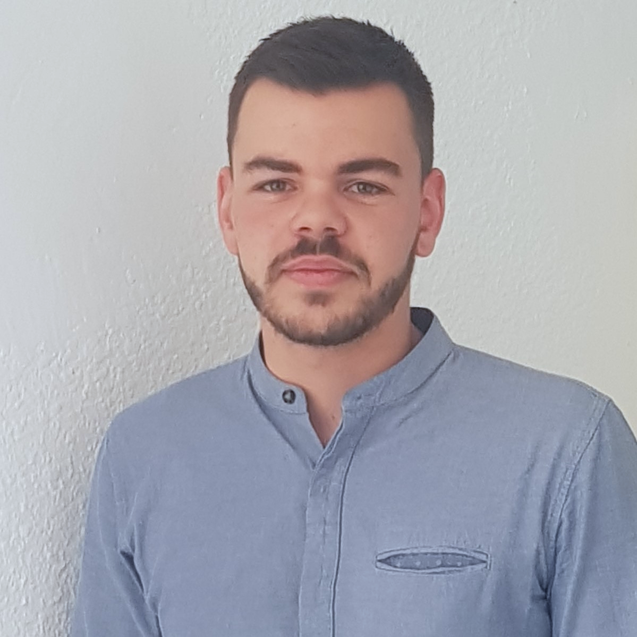
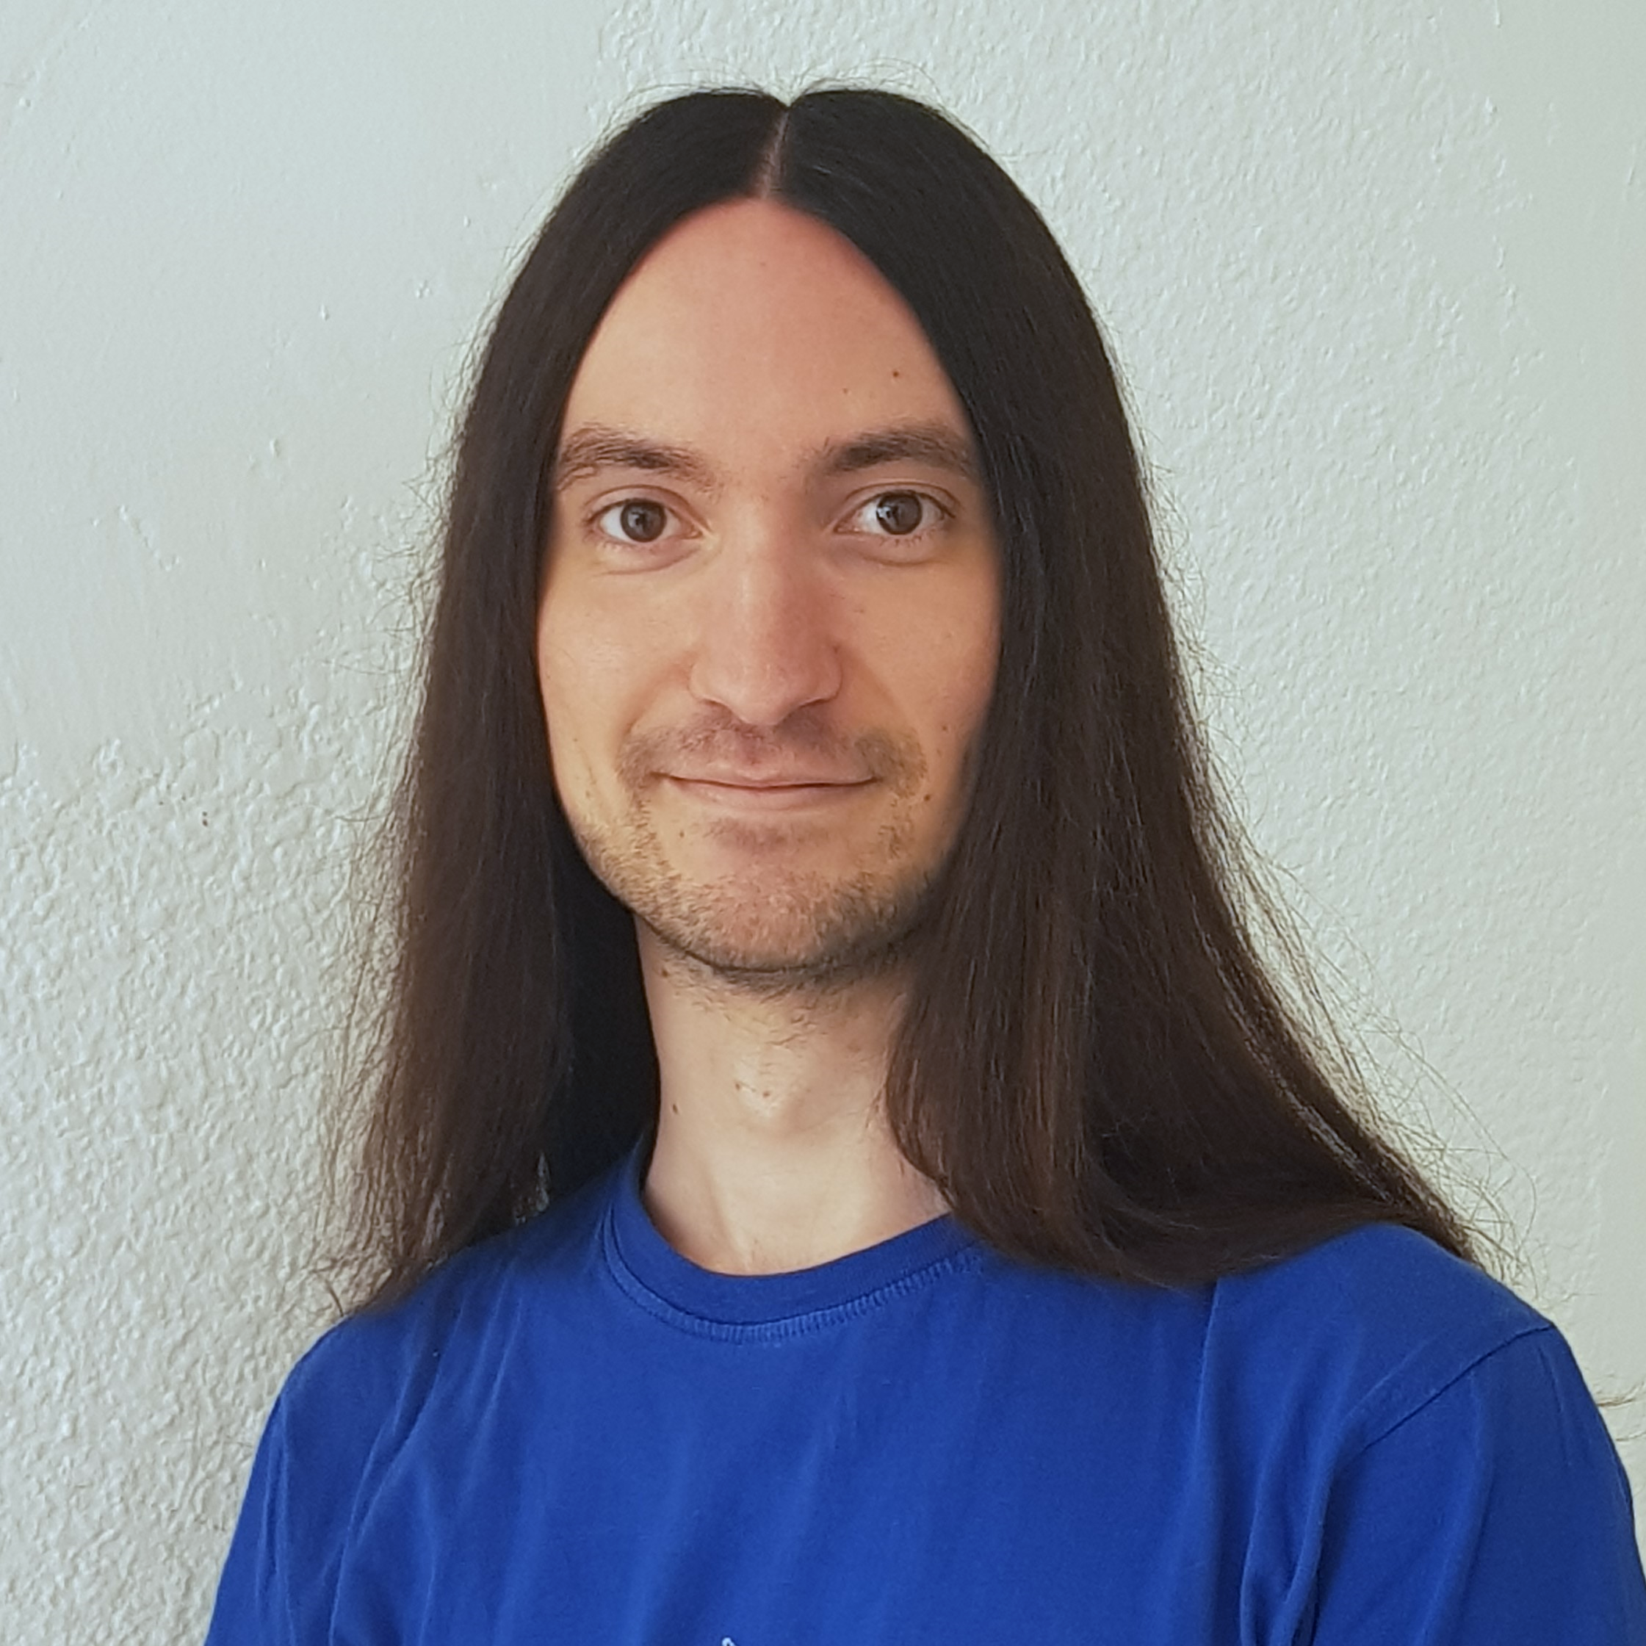


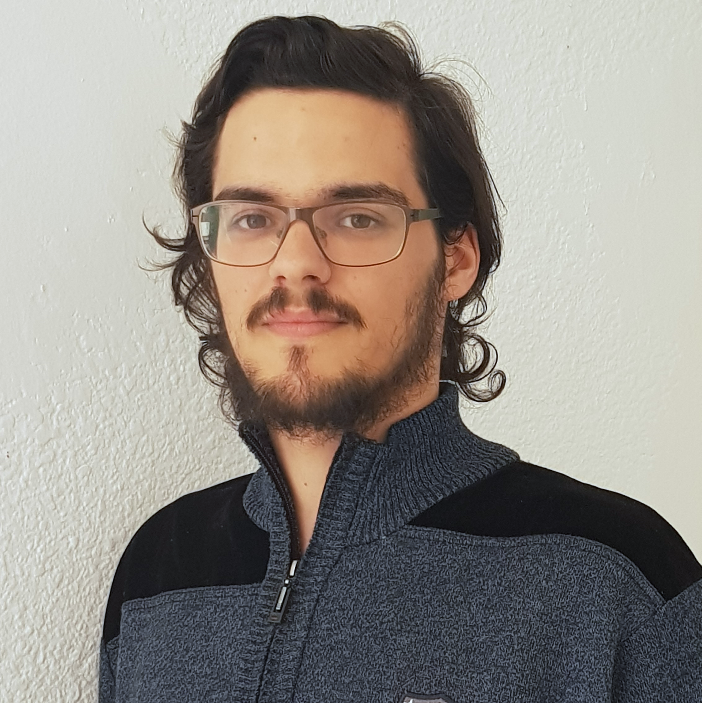



Pablo Rebollo
Project manager, backend developer
Juan Rodríguez
Requirements engineer, backend developer
Adrián Cantón
Business manager, full-stack developer
Rafael Fresno
Backend developer, API integration
Daniel Carpio
Analist,
frontend developer

Slide 11
COSTS
How much does Capsulefy cost?

Slide 12
Project duration | 4 months
Salaries | 20.80 €/hour
Hours per month | 40
Equipment | 306 €
Hosting, advertising and support | 18,729 €
Risk prevention | 10% (2,724 €)
Total | 44,968 €

Slide 13
DEMO
How does the system look like?

Slide 14
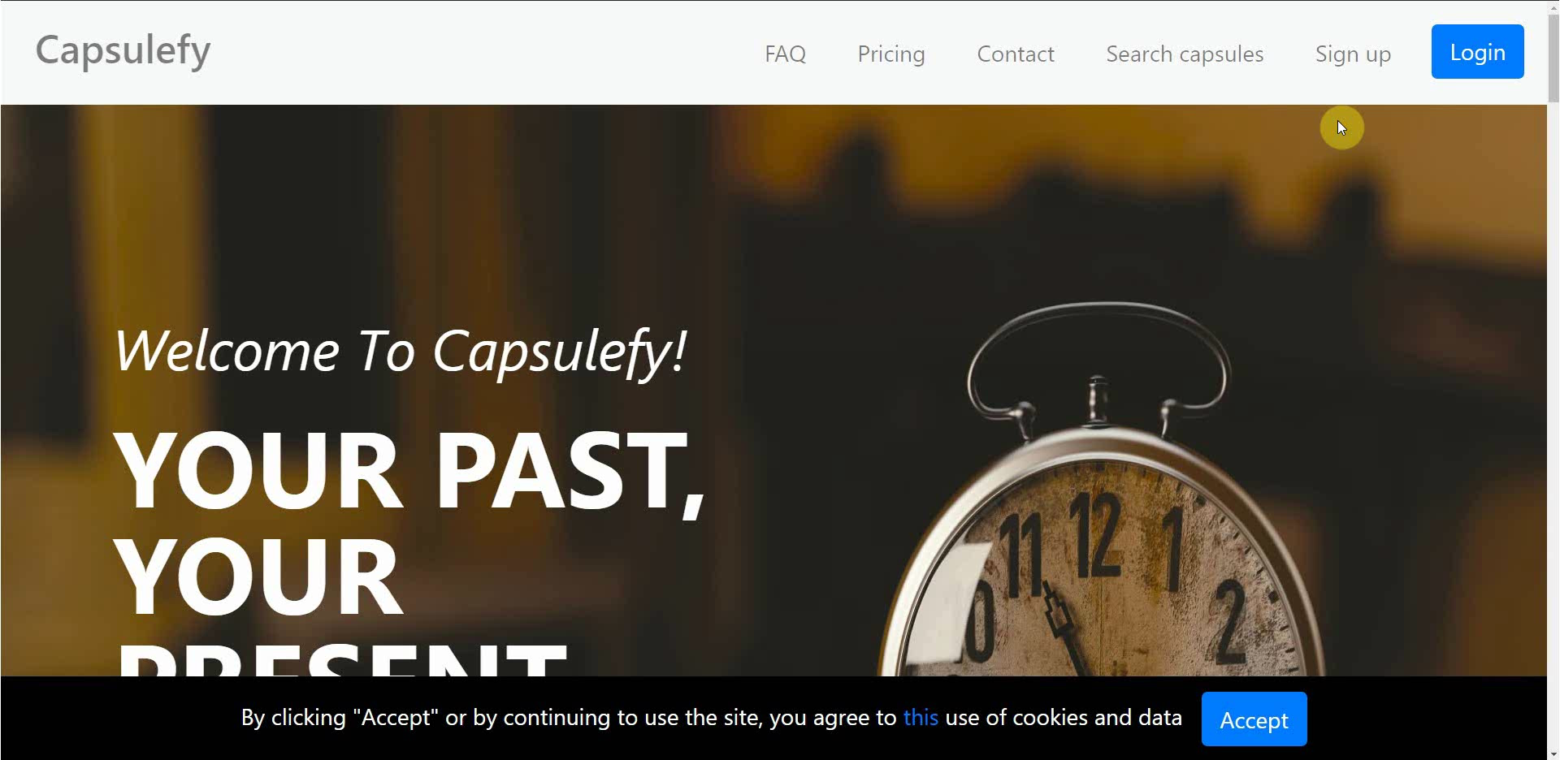
No logged user – Sign up

Slide 15
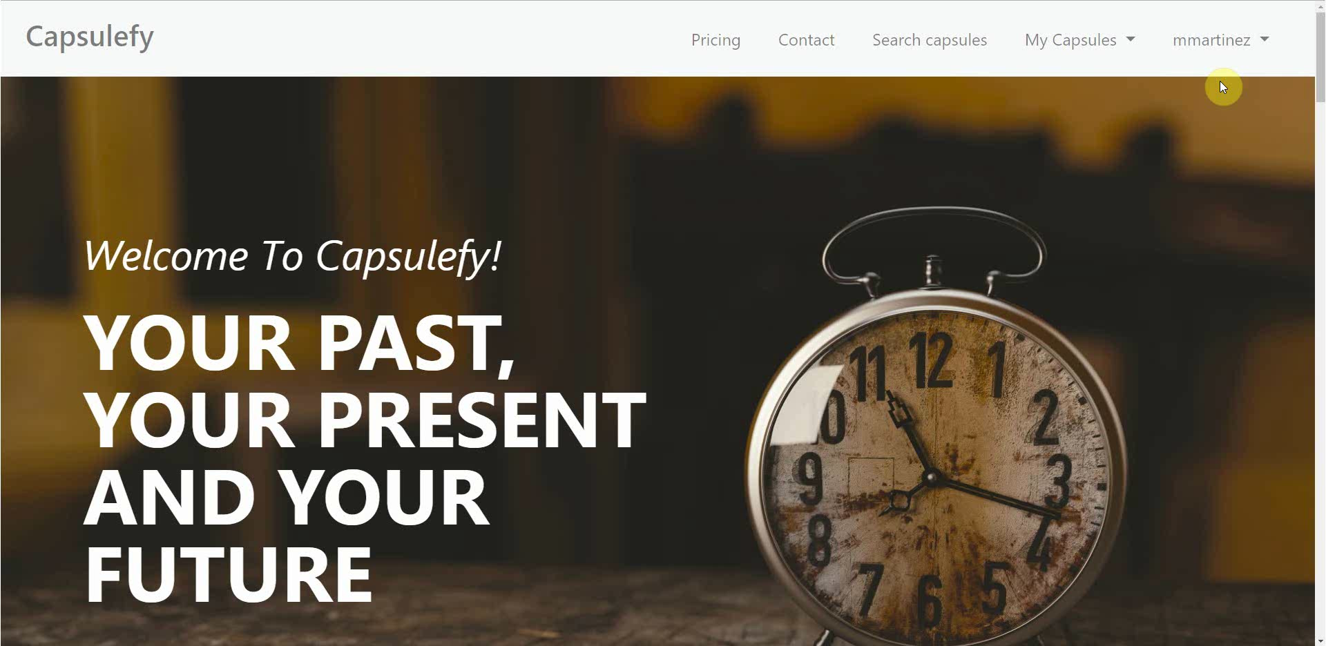
Logged-in user – Connect to Twitter

Slide 16
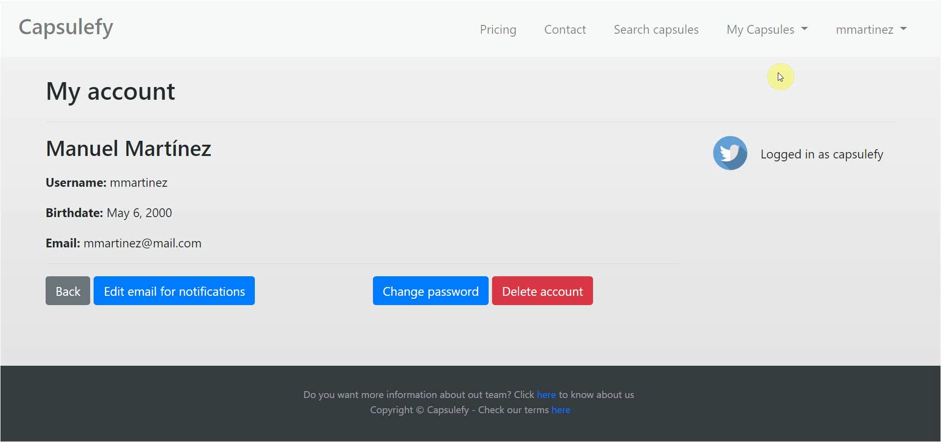
Logged-in user – Create capsule

Slide 17
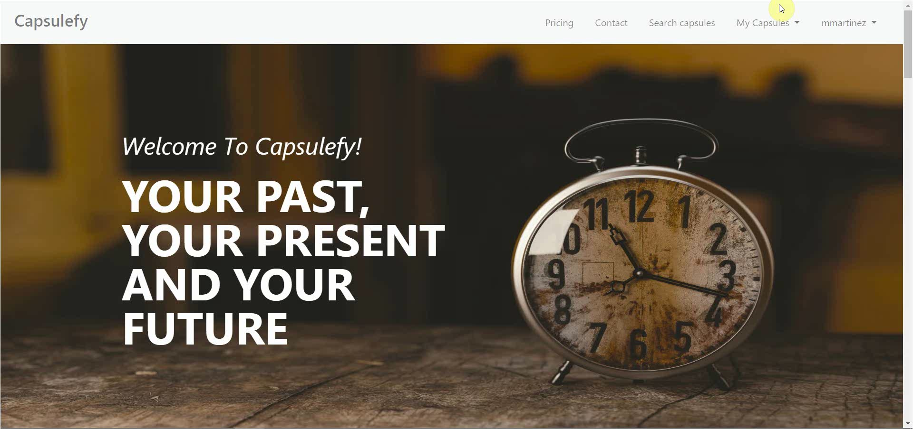
Logged-in user – Refresh timer

Slide 18
SWOT analysis
What are our strong and weak points?

Slide 19















Deadman switch
Highly customizable
More storage
Free plan
New to the market
Hard to understand
Only PayPal
S
W
No monopolies
Insurance companies
Special days
Wide target
Competitors
Lack of trust
Number of users
Written last wills
O
T

Slide 20



Threat mitigation
- Keep improving
- Maintain prices
Competitors

Slide 21




Threat mitigation
- Advertising
- Assure clients get
what they pay for
- Special promotions
Lack of trust

Slide 22




Threat mitigation
- Marketing
- Focus on profitable
channels
- Research the market
Number of users

Slide 23



Threat mitigation
- Appeal to wider
audience
- Focus on social
components
Written last wills

Slide 24
Return of investment
How are we making profit?

Slide 25
Project duration | 14 weeks
Salaries | 14,390 €
Equipment | 325 €
Hosting | 669 €
Advertising | 3,060 €
Customer support | 18,729 €
Risk prevention | 10% (2,724 €)
Total | 36,168 €

Slide 26

During our 1st month…
100-200 capsules sold
First week free
20% discount during next three weeks
Total revenue: ~1,140 €

Slide 27


During our first 6 months…
700 capsules sold
~500 capsules at full price
4,750 € during this period
Total revenue: ~5,990 €

Slide 28
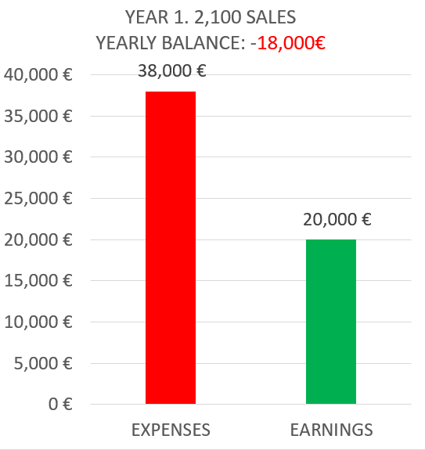
During our next 6 months…
3,060 € for advertisement campaign
~1,400 sales
13,300 € during this period

Slide 29
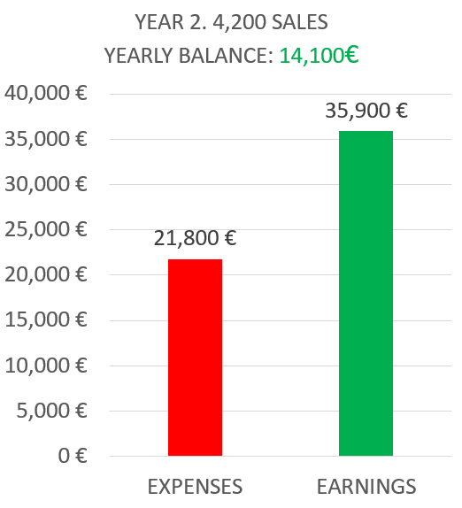
During our second year…
Some discount campaigns
Hosting, advertising and customer support
Double the first year sales

Slide 30
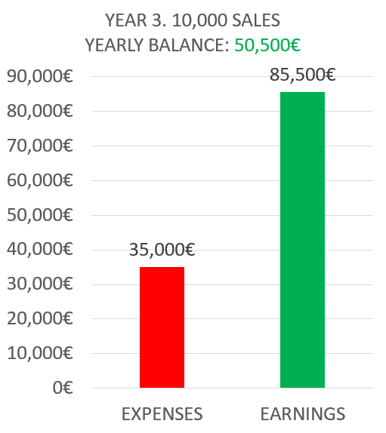
During our third year…
Aggressive expansion plan
Double the marketing budget
Increase maintenance costs

Slide 31
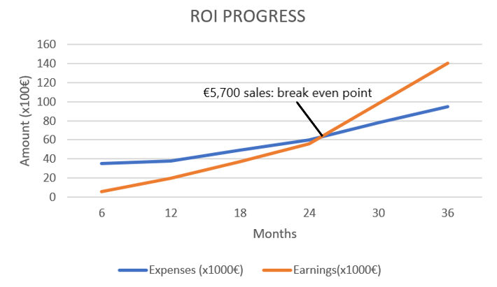

Slide 32
Investment analysis
What is our commitment to investors?

Slide 33

As of today…
35k € invested in development
20k € remaining
Need to find investors for 55k €

Slide 34

Our compromise
Investors get 110% back
We need to return 60k €
Amount achieved after 3rd year
Investors get a percentage based on their inversion (a share)
%

Slide 35
Shares
90k € to succeed
60%
owned by investors
40%
owned by the team
8%
for each member

Slide 36

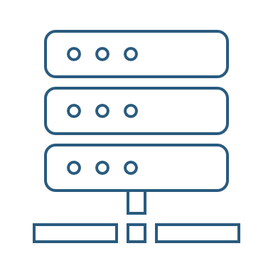

We are investing in…
Customer support
Advertising
Hosting
Storage

Slide 37



Our conditions
Minimum 500 € inversions
Initial loan of 20k €
More loans or reduced budget if needed

Slide 38
Postmortem analysis
How did development go?

Slide 39





Late Facebook integration
No clear initial business idea
Compatibility issues

Slide 40


All deadlines met
Satisfied pilot users

Slide 41
Deliverable results
What was produced?

Slide 42


Final version:
https://capsulefy.herokuapp.com
GitHub release:
https://github.com/pabreblob/capsulefy/releases (Release 6)
All related documentation

Slide 43
Thanks!
https://capsulefy.herokuapp.com
Landing page: https://capsulefy01.herokuapp.com
Contact email: capsulefy.communications@gmail.com
GitHub releases: https://github.com/pabreblob/capsulefy/releases

Slide 44


Deadman switch
ON

Slide 45
TECHNOLOGIES
What stack do we use?

Slide 46



Web app
Users and capsules
Media storage
Social network

Slide 47


Teamwork
Skills
Profitable work
Positive feedback

Slide 48
Realistic | 44968 – 46330 €
Optimistic | 43061 €
Pesimistic | 49054 €
Project duration: 4 months

Slide 49


Risk | Mitigation
Broken computer | Risk prevention funds
Changing terms of use | Monitor
Servers down | Monitor
Incompatible timetables | Reschedule

Slide 50
Year 1: 2000 sales
Balance: -25168 €
Year 2: 4000 sales
Balance: 11441 €
44968 €
39600 €
28159 €
19800 €
Costs
Earnings
Costs
Earnings

Slide 51
Year 3: 8000 sales
Balance: 36450 €
79200 €
29023 €
Costs
Earnings

Slide 52


What do we store?
Users:
- Full name
- Email
- Birthdate
- Notification email
- Social network token
Capsules:
- Content
- Files
- Emails
- Payment ID

Slide 53


Create manual
Create test suite
Test the system
Gather feedback
Fill form

Slide 54
Sprint 2
Users receive and fill form
March 30 – April 6
Development
April 8 – April 12
Receive users feedback
April 6
Planification
April 8

Slide 55
Sprint 3
Easter Week
Users receive and fill form
April 12 – April 22
Development
April 22 – May 3
Receive users feedback
April 22
Planification
April 22

Slide 56



GDPR and measure calculation costs are included in the corresponding members’ salaries

